Slide 1
CROWDSTRIKE Presents
CrowdStrike India Hackathon
AIR TRAFFIC FLOW MANAGEMENT

Slide 2


Brief explanation of the idea what makes it unique
We can even enter data into the data set and modify data into data set
We are getting an schedule of all the airlines that are present in between two cities in an order
We are even sorting the schedule based on the air travel time and get a sorted schedule
The user must enter any two cities present in the data set and we will obtain all the options present in between the cities and even information regarding the airlines
We are getting all the available option between two cities that is the optimal itinerary between two cities and even the minimum number of hops possible
We are even getting the maximum demand rate for each airline and which are the ones most preferable by the passengers
We are obtaining an graph showing relation in between all the airports

Slide 3

The scheduling problem (Approach)
A simple approach is being used in this scheduling problem.
The programming language used here in python3
And the execution is being done completely in Jupyter notebook.
We have trained the algorithm model on the basis of the data set created by us and its attributed.
Enter two cities in between whom you want to find the schedule.
The data set is being read then we are sorting the data set on the basis of the origin and the destination.
The data set is then sorted on the basis of the time in which the airplane was present in air
The attributes used here are “ORIGIN” “DEST” and “AIR_TIME”
Any data set with these attributes will surely show an desired schedule(i.e the output)
The scheduling problem (Approach)
We have used Jupyter Notebook to solve this problem.
The Schedule is done on the bases of the attributres :
“AIRLINE NAME”,ORIGIN”,”DEST”,”AIR_TIME”.
We have sorted the dataset in the order of origin and destination using the Data Sorting Algorithm so that it will be easy to perform operations on the Dataset.
We have used Pandas for all Data Operations.

Slide 4

The Schedule problem
(Source code)
https://github.com/AdityaPrabhuCS/hackathon.git
https://github.com/AdityaPrabhuCS/Quantico/blob/master/Schedule.py
https://github.com/AdityaPrabhuCS/hackathon/tree/master/SCHEDULE
https://github.com/AdityaPrabhuCS/Quantico

Slide 5
The optimal itinerary problem(Approach).
A simple approach is being used in this scheduling problem.
The programming language used here in python3
And the execution is being done completely in Jupyter notebook.
We have trained the algorithm model on the basis of the data set created by us and its attributed.
Enter two cities in between whom you want to find the schedule.
The data is made into a form of graph using netwotkx and then analyzed
We obtain all the possible ways with whose help we can reach from the origin to destination and even the least path which can be followed
The attributes used here are “ORIGIN” “DEST”
This is a generalized sort of approaching a problem and will surely give us all the possible path

Slide 6
The optimal itinerary problem
(Source code)
https://github.com/AdityaPrabhuCS/hackathon.git
https://github.com/AdityaPrabhuCS/Quantico/blob/master/Optimal.py
https://github.com/AdityaPrabhuCS/hackathon/tree/master/OPTIMAL%20ITENARY
https://github.com/AdityaPrabhuCS/Quantico

Slide 7

The demand dare problem(Approach)
A simple approach is being used in this scheduling problem.
The programming language used here in python3
And the execution is being done completely in Jupyter notebook.
We have trained the algorithm model on the basis of the data set created by us and its attributed.
Enter two cities in between whom you want to find the schedule.
The data set is being read then we are sorting the data set on the basis of the origin and the destination.
The data set is then sorted on the basis of the numbers of passengers travelling from one city to another
The attributes used here are “ORIGIN” “DEST” and “PASSENGERS_ON_WAY”
Any data set with these attributes will surely show an desired schedule(i.e the output)

Slide 8
The demand rate problem
(Source code)
https://github.com/AdityaPrabhuCS/Quantico/blob/master/Demand.py
https://github.com/AdityaPrabhuCS/Quantico

Slide 9
Technology/Tool Stack
The technological stack used in this whole application are
Programming language-Python 3
IDE used – Jupyter notebook
Libraries used are
Pandas
Numpy
Networkx
Csv
Data set used is obtained from kaggle

Slide 10

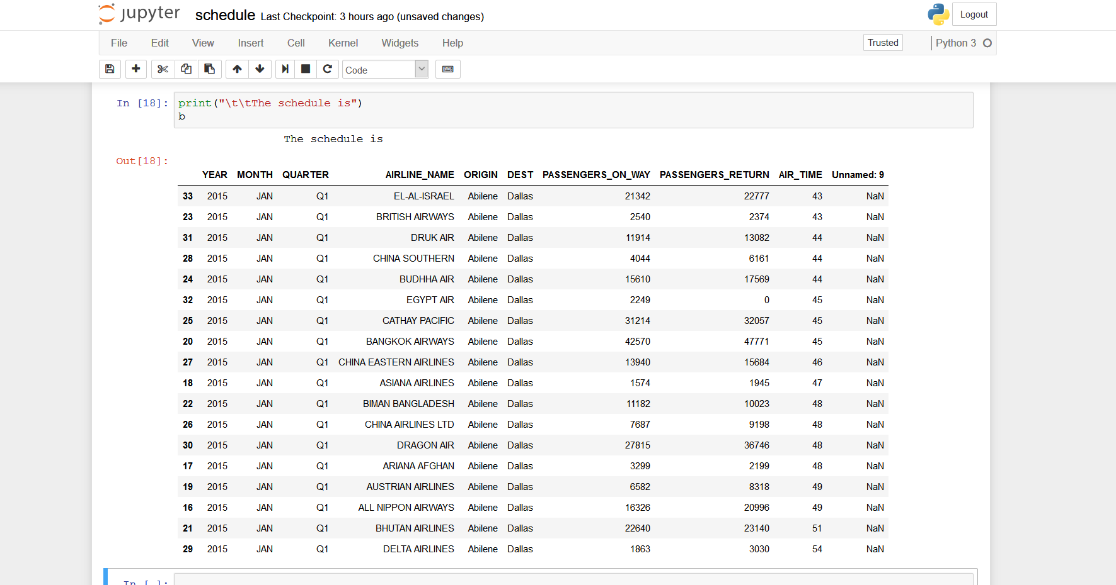
Prototype screenshots of all the output
Prototype screenshots of all the output
THE SCHEDULE IS OBTAINED AS SHOWN

Slide 11

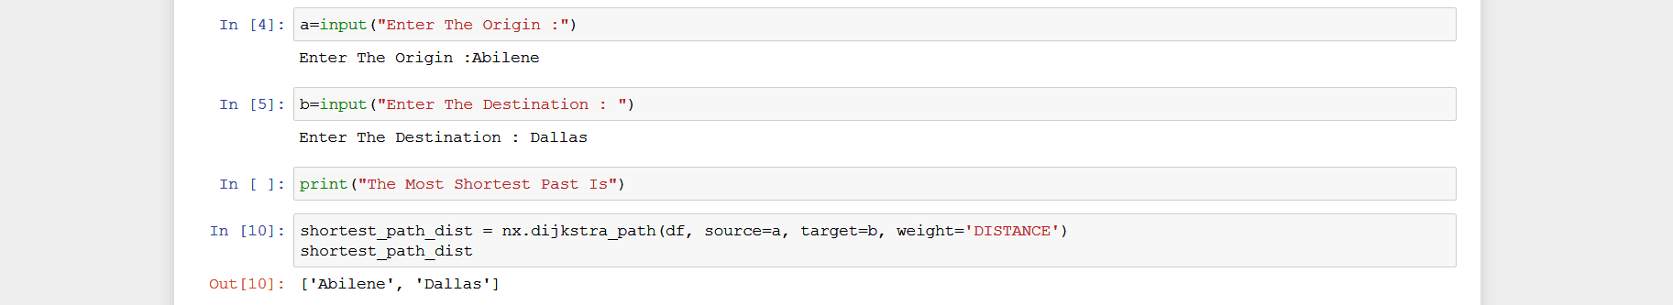

Prototype screenshots of all the output
THE OPTIMAL PATH IS IS OBTAINED AS SHOWN

Slide 12
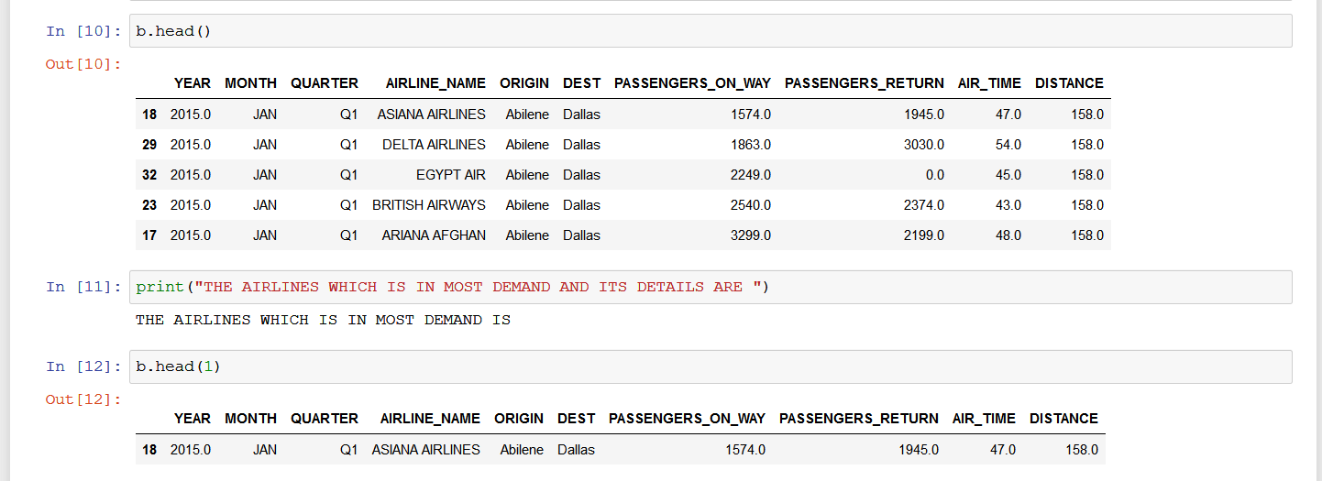
Prototype screenshots of all the output
THE DEMAND RATE IS IS OBTAINED AS SHOWN

Slide 13
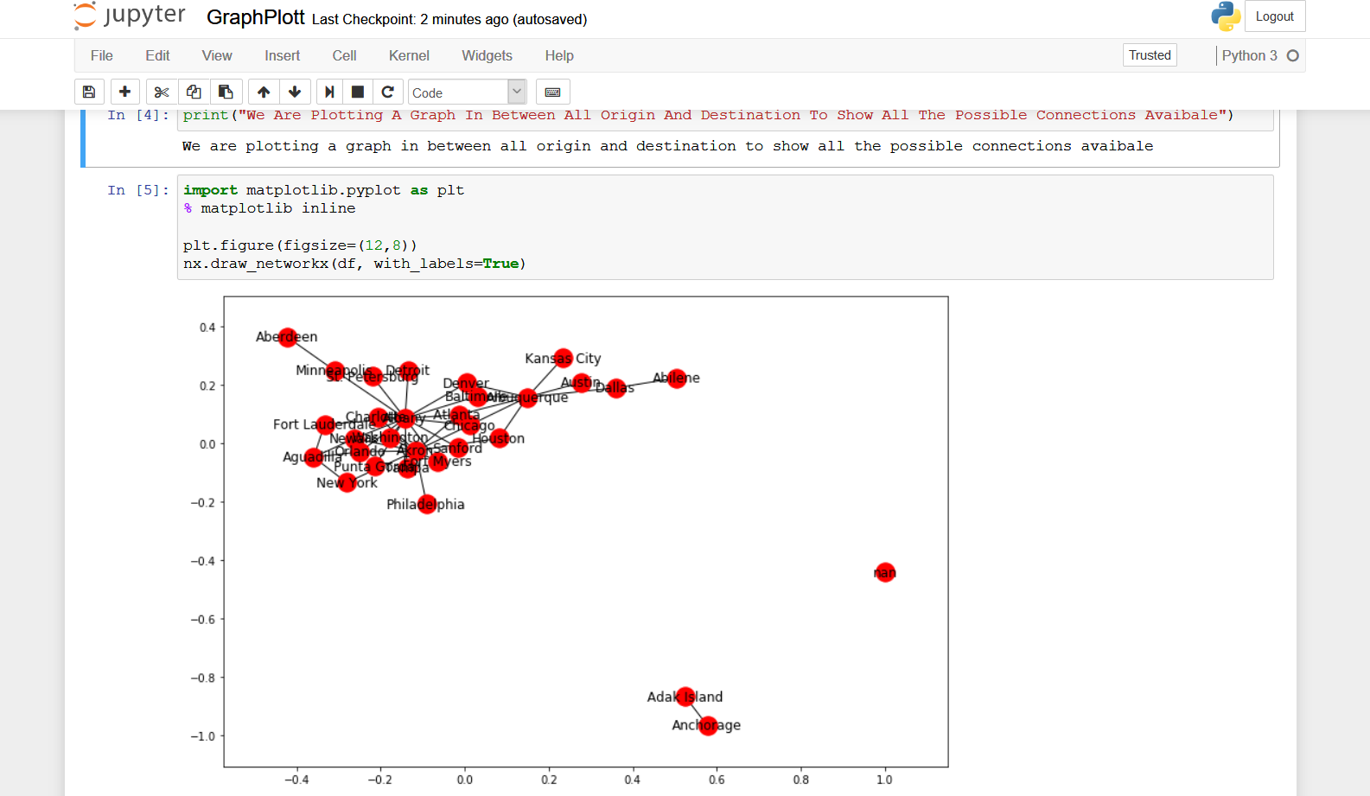
Prototype screenshots of all the output
THE GRAPH OF SOURCE AND DESTINATION IS OBTAINED AS SHOWN

Slide 14

Possible Improvement
ALL THE POSSIBLE IMPROVEMENTS WHICH CAN BE DONE BUT
Creating a gui to perform all these operations and even obtaining the desired output.
Graphical representation of multiple data
Locating the present location of the airplane
Predicting all details like which flights demand will increase where to find a specific airplane and all such predictions
Graphical representation of all different data which makes all the operations simple and easier to understand.
Creating an mobile application or a software which carries out multiple functions

Slide 15
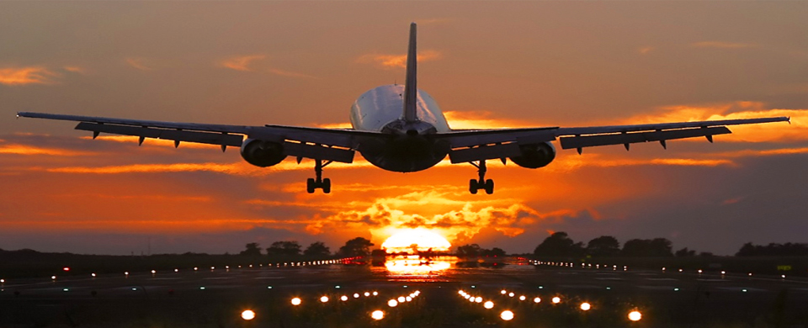
Challenges faced
The challenges faced are
there will be continuous updating of the data
Insufficiency of the data available
Raw data in large quantity

Slide 16
EXTRA IMPROVEMENTS MADE BY US
GRAPH OF SOURCE AND DESTINATION
https://github.com/AdityaPrabhuCS/Quantico/blob/master/GraphPlott.py
GRAPH OF ANY CITY TO THAT OF NUMBER OF PASSENGERS
https://github.com/AdityaPrabhuCS/Quantico/blob/master/plotgraphwrtanycity.py
ENTERING DATA INTO DATASET AND DISPLAYING
https://github.com/AdityaPrabhuCS/Quantico/blob/master/enterdisplay.py

Slide 17
